Slide 1
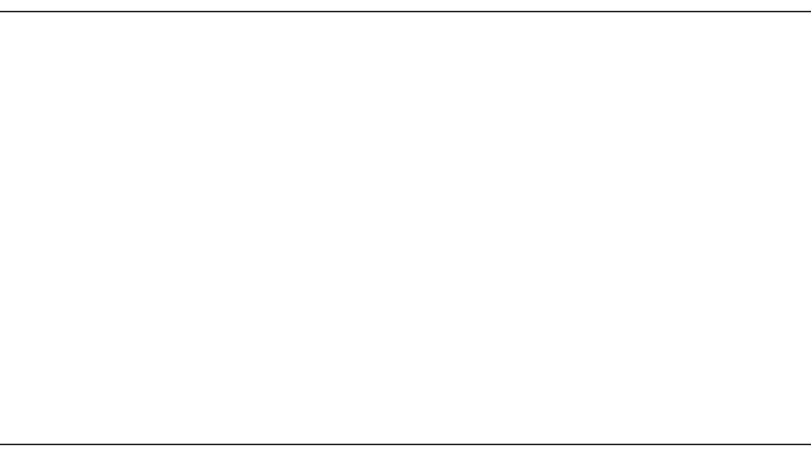
OLD TESTAMENT
Deuteronomy 32:36–39

Slide 2
³⁶The LORD will vindicate his people
and have compassion on his servants,
when he sees that their power is gone
and there is none remaining, bond or free.

Slide 3
³⁷Then he will say, “Where are their gods, the rock in which they took refuge, ³⁸who ate the fat of their sacrifices and drank the wine of their drink offering? Let them rise up and help you; let them be your protection!”

Slide 4
³⁹“See now that I, even I, am he, and there is no god beside me; I kill and I make alive; I wound and I heal; and there is none that can deliver out of my hand.”

